Slide 1

Analytical CRM Development for a Bank
LOKESH REDDY CHILUKA
Notes:
Line spacing + Page numbers

Slide 2
Agenda
Problem Statement
Data Overview
Workflow
Key Metrics & Insights
Recommendations
Conclusion

Slide 3
PROBLEM STATEMENT
You are an analytical CRM (Customer Relationship Management) specialist hired by a bank to extract meaningful insights from customer-related datasets.
The bank aims to reduce customer churn, improve service delivery, and enhance customer satisfaction.
The datasets provided include customer demographics, transaction details, customer exit information, and active customer profiles.

Slide 4
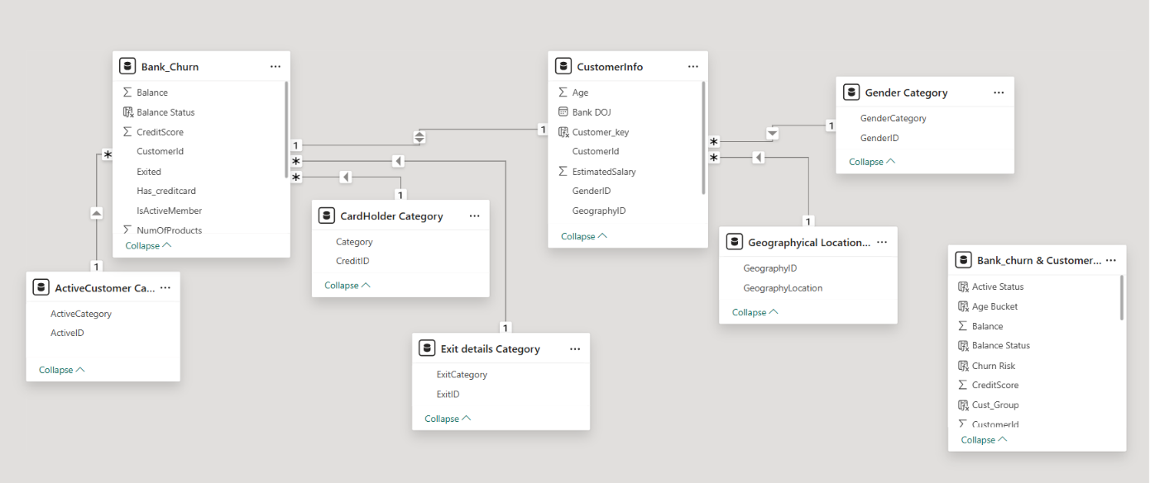
Dataset Overview

Slide 5
Dataset Overview
The project initially consisted of multiple datasets, including customer information, credit card details, activity status, geography, and exit information.
These datasets were consolidated and transformed into a single master dataset using Excel Power Query for efficient analysis.
It includes key customer attributes such as:
Customer Information (CustomerId, Surname, Gender, Age, Geography)
Account Details (Tenure, Balance, Number of Products)
Financial Metrics (Credit Score, Estimated Salary)
Customer Engagement (Active Status, Credit Card Usage)
Churn Information (Exited, Exit Category)

Slide 6
WORKFLOW
Data Acquisition from multiple source systems
Data Cleaning and Preprocessing using Excel Power Query
Data Integration and Transformation into a unified dataset
Data Storage and Querying using SQL
Data Visualization through interactive Power BI dashboards
Insight Generation to support data-driven decision making

Slide 7
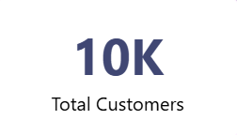
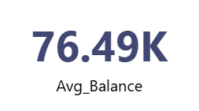

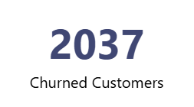
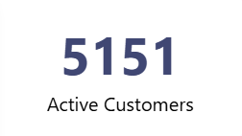
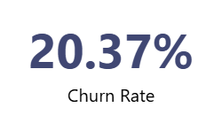
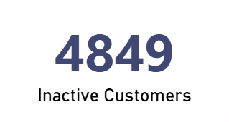
Key Performance Indicators

Slide 8
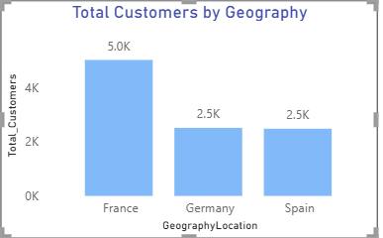
Geography Analysis
France has the highest customer base with approximately 5K customers, indicating strong market presence compared to other regions.
Germany and Spain each contribute around 2.5K customers, showing balanced customer distribution across these two geographies.
The analysis highlights France as the dominant geography, which can help businesses focus retention and growth strategies region-wise.

Slide 9
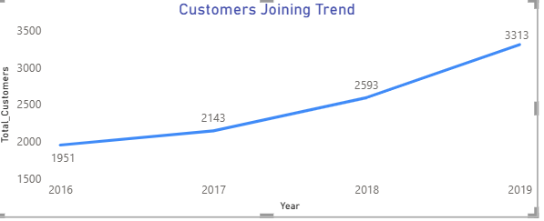
Customer Acquisition Trend
The customer joining trend shows consistent growth from 2016 to 2019, increasing from 1,951 customers to 3,313 customers.
A significant rise in customer acquisition is observed after 2017, indicating improved customer engagement and business expansion.
The upward trend highlights positive business performance and increasing customer interest over the years.

Slide 10
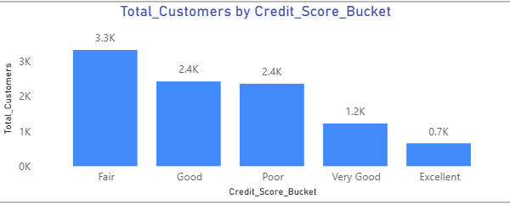
Customer Distribution by Credit Score
Customers with a Fair credit score category represent the highest customer count at approximately 3.3K customers.
The Good and Poor credit score categories each contribute around 2.4K customers, showing moderate customer distribution.
Customers with Very Good and Excellent credit scores are comparatively lower, indicating that most customers fall within average credit score ranges.

Slide 11
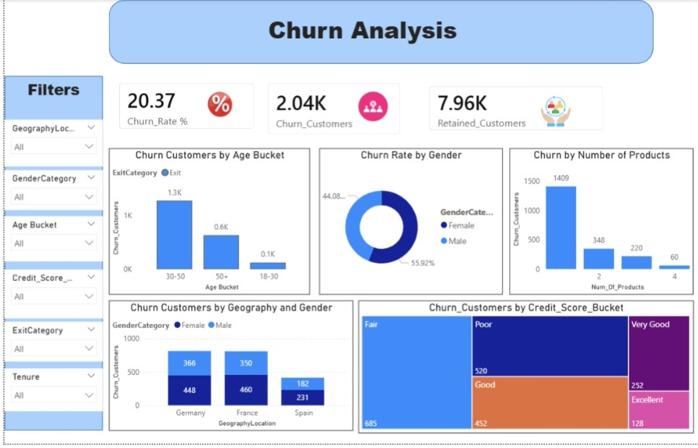
Churn Analysis Dashboard

Slide 12
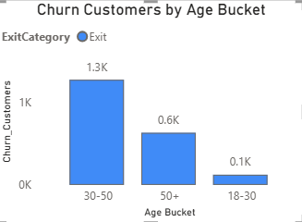
Churn Customers by Age Group
Customers in the 30–50 age group show the highest churn count at approximately 1.3K customers, indicating higher customer attrition in this segment.
The 50+ age category contributes around 0.6K churned customers, showing moderate churn behavior among senior customers.
Customers aged 18–30 have the lowest churn count, suggesting better retention among younger customers.

Slide 13
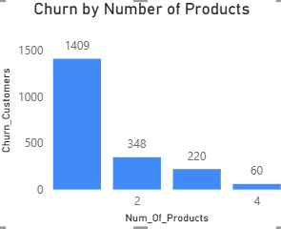
Churn by Number of Products
Customers with only 1 product show the highest churn count at approximately 1,409 customers, indicating higher attrition among single-product users.
Churn decreases significantly as the number of products increases, suggesting that multi-product customers are more likely to stay with the bank.
Customers with 4 products have the lowest churn count, highlighting the positive impact of product engagement on customer retention.

Slide 14
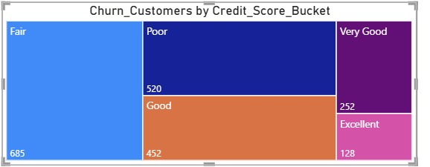
Churn by Credit Score Segment
Customers with Fair credit scores contribute the highest churn count at approximately 685 customers, indicating greater customer attrition in this segment.
Poor and Good credit score categories also show notable churn levels with around 520 and 452 customers respectively.
Customers with Very Good and Excellent credit scores have comparatively lower churn counts, suggesting better retention among financially stable customers.

Slide 15
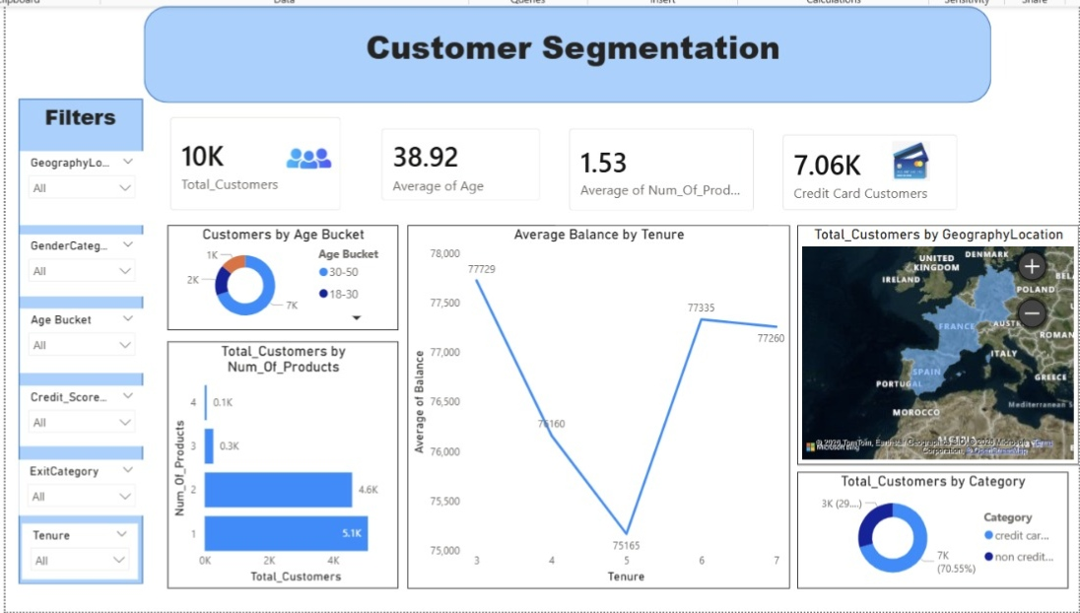
Customer Segmentation Dashboard

Slide 16
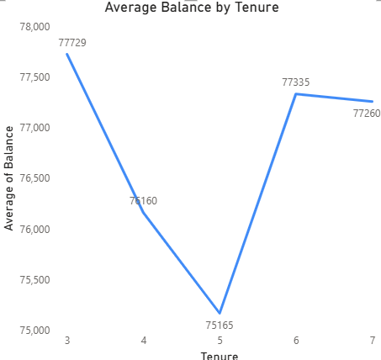
Average Balance Analysis by Tenure
The average customer balance fluctuates across different tenure periods, indicating varying customer financial behavior over time.
Customers with a tenure of 3 years show the highest average balance at approximately 77.7K, while tenure 5 records the lowest average balance around 75.2K.
After a decline between tenure 3 and 5, the average balance increases again for tenure 6 and 7, showing improved customer balance retention in later years.

Slide 17
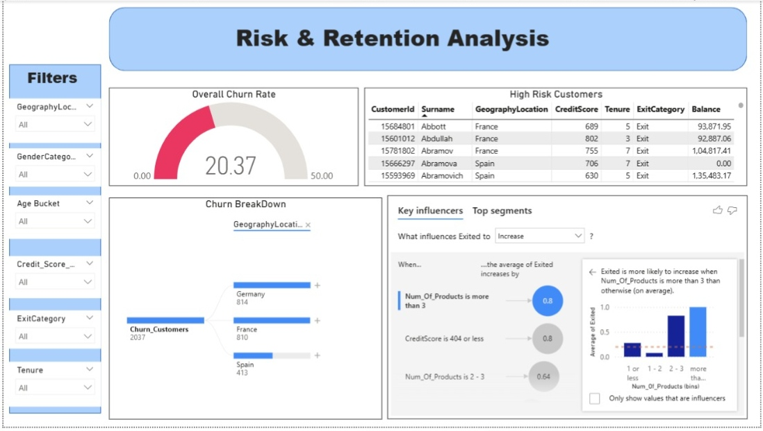
Risk & Retention Analysis Dashboard

Slide 18
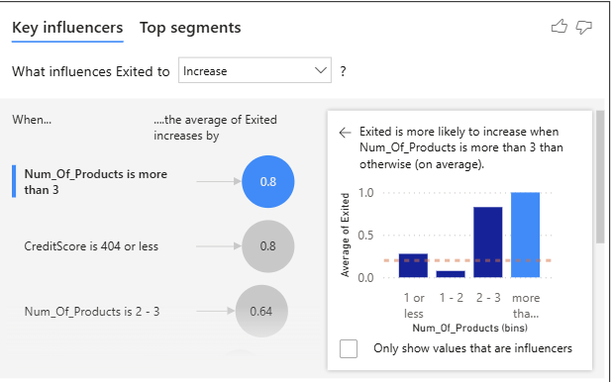
Key Influencers for Customer Churn
The Key Influencers visual identifies factors that significantly increase customer churn.
Major churn drivers include:
• Low credit score
• Higher product count
• Customer inactivity
• Geography factors

Slide 19
Recommendations
• Focus on inactive customers
• Reduce churn in Germany
• Promote multi-product adoption
• Improve engagement for older customers
• Monitor low credit score customers
• Use predictive analytics for churn prevention
• Strengthen customer satisfaction programs

Slide 20
Conclusion
The project successfully analyzed customer churn behavior using SQL and Power BI.
The dashboards provide actionable insights into:
• Customer retention
• Customer segmentation
• Product usage behavior
• High-risk customer identification
The analysis helps banks make data-driven business decisions.

Slide 21
Thank You

